Slide 1


INTRODUCTION
Background
“Global Mart” is an online store super giant having worldwide operations. It takes orders and delivers across the globe
It deals with all the major product categories - consumer, corporate & home office.
The “Global Mart” store caters to 7 different market segments and in these 3 major categories i.e at total 21 levels.
Objective
To forecast the sales and demand for the next 6 months ,in order to manage the revenue and inventory accordingly. And to find out 2 most profitable (and consistent) segment from these 21 and forecast the sales and demand for these segments

Slide 2




Problem solving methodology
Business & Data Understanding
Data Preprocessing
EDA & Visualization
Model Building
To understand the no. of markets,store is dealing with and product categories stor ecaters to different segments
Data was sourced from UpGrad & cleaned –
EDA performed using techniques like –
Model Built considering both classical decomposition and auto ARIMA for forecasting
1 data file(Global Superstore)
File has 51290 observations
Contains no NA values
Removing duplicates
Subsetting data into different market according to different segments.
Converting date to suitable format.
Removing Outliers
Deriving Metrics
Treating NA values
Converted transaction-level data into a time series

Slide 3
Problem solving methodology
Model Evaluation
Conclusions
Model Evaluation by
1.MAPE
Testing done to assure no predictability remains:
1.Kpss Test
2.ADF test

Slide 4


Quick Summary
Key Take-Away --
1.Top two most profittable Market comes out to be –APAC and EU
2.In these Market most profitable segments are –Consumer
- APAC-consumer → 222817.560 (CV= 0.6321323)
-EU-consumer → 188687.707(CV= 0.6243052)
Programming done in : R

Slide 5
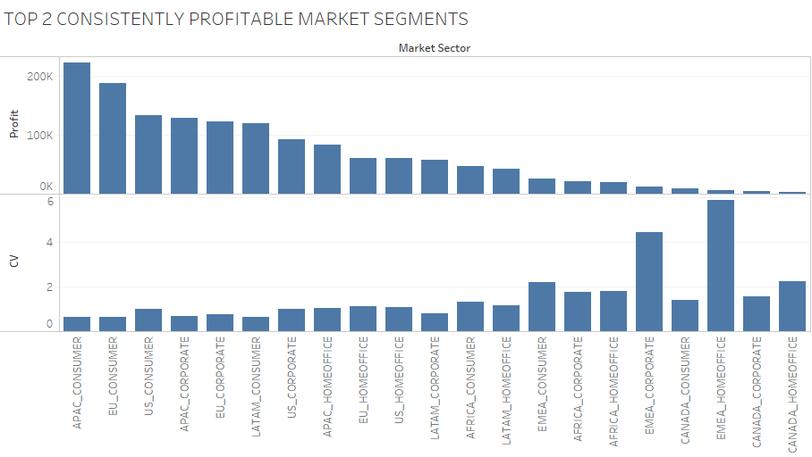
PLOT OF PROFIT AND CONSISTENCY OF DIFFERENT MARKET SEGMENTS
Top 2 Consistently Profitable Market segments

Slide 6
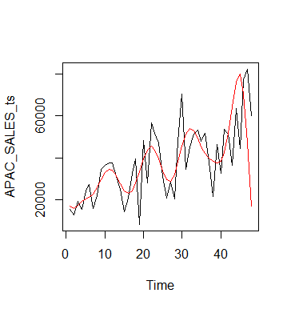
Modelling time series Using classical decomposition For APAC market sales
Black lines shows the original values and Red line is the predicted one.
Using MAPE evaluation technique we get accuracy of 49.97%

Slide 7
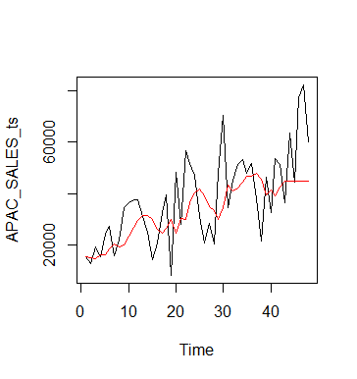
Modelling Time series using Auto Arima method for APAC market sales
Black lines shows the original values and Red line is the predicted one.
Using MAPE evaluation tecnique ,accuracy comes out to be 27.69%

Slide 8
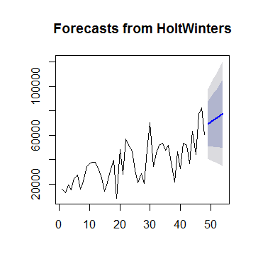
Forecasting for next 6 months for APAC market Sales
Forecasting for next 6 months using Holt Winters

Slide 9
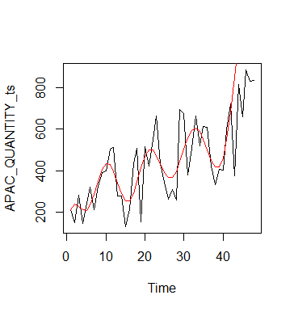
Modelling time series Using classical decomposition For APAC market (Quantity)
Black lines shows the original values and Red line is the predicted one.
Using MAPE evaluation tecnique Accuracy we get :62.10%

Slide 10
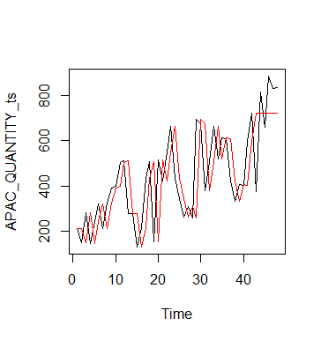
Modelling Time series using Auto Arima method for APAC market (Quantity)
Black lines shows the original values and Red line is the predicted one.
Using MAPE evaluation tecnique ,accuracy comes out to be 26.24%

Slide 11
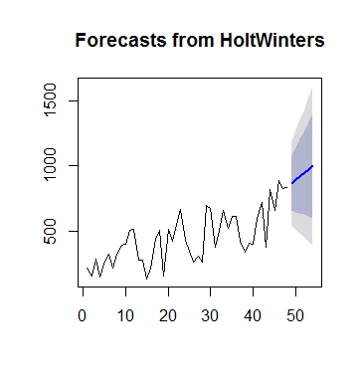
Forecasting for next 6 months for APAC market (Quantity)

Slide 12
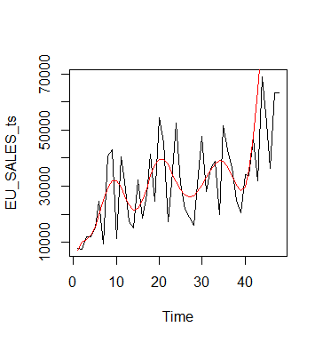
Modelling Time series using Classical Decomposition method for EU market (Sales)
Black lines shows the original values and Red line is the predicted one.
Using MAPE evaluation tecnique ,accuracy comes out to be 92.96%

Slide 13
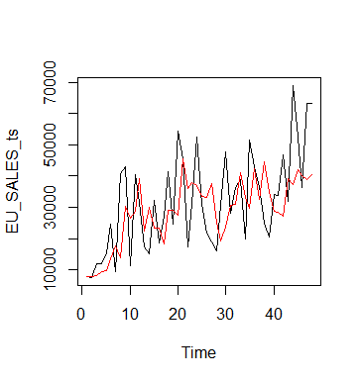
Modelling Time series using Auto Arima method for EU market (Quantity)
Black lines shows the original values and Red line is the predicted one.
Using MAPE evaluation tecnique ,accuracy comes out to be 28.92%

Slide 14
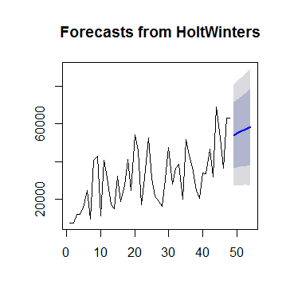
Forecasting for next 6 months for EU market Sales
Forecasting for next 6 months using Holt Winters

Slide 15
Conclusions and Recommendations

